Slide 1

North Fond du Lac
School District
My Stop Application – Download Instuctions

Slide 2
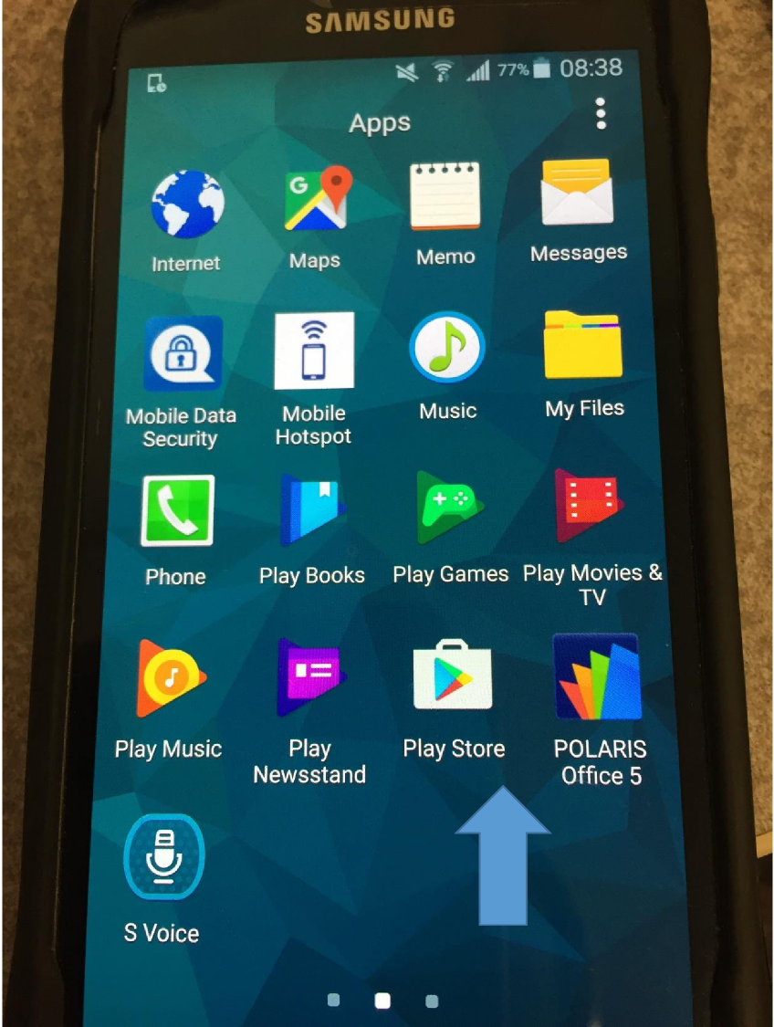
My Stop Download
To install the MyStop
Application on smart phones or other hand held device,
please go to the
App Store. Here
is an example of what
the App Store icon looks
like.

Slide 3
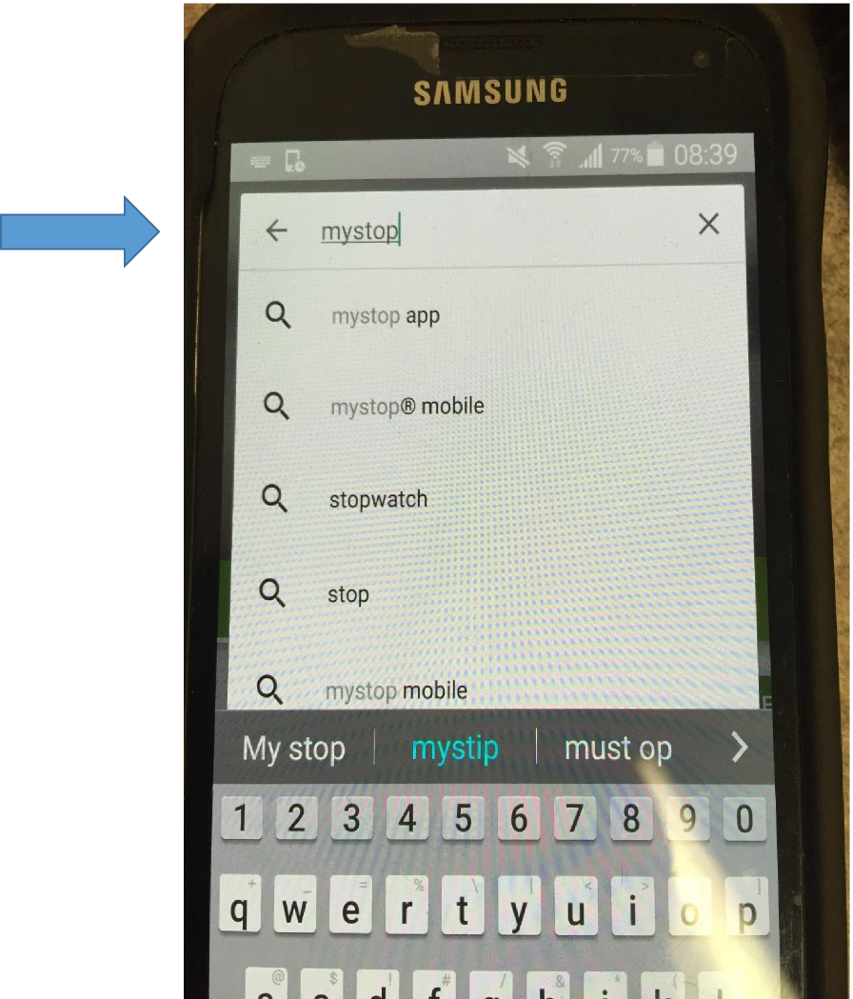
My Stop
Download
Once you are in the
App Store, go
to the top where
there is a search bar
In the search bar,
type MyStop

Slide 4
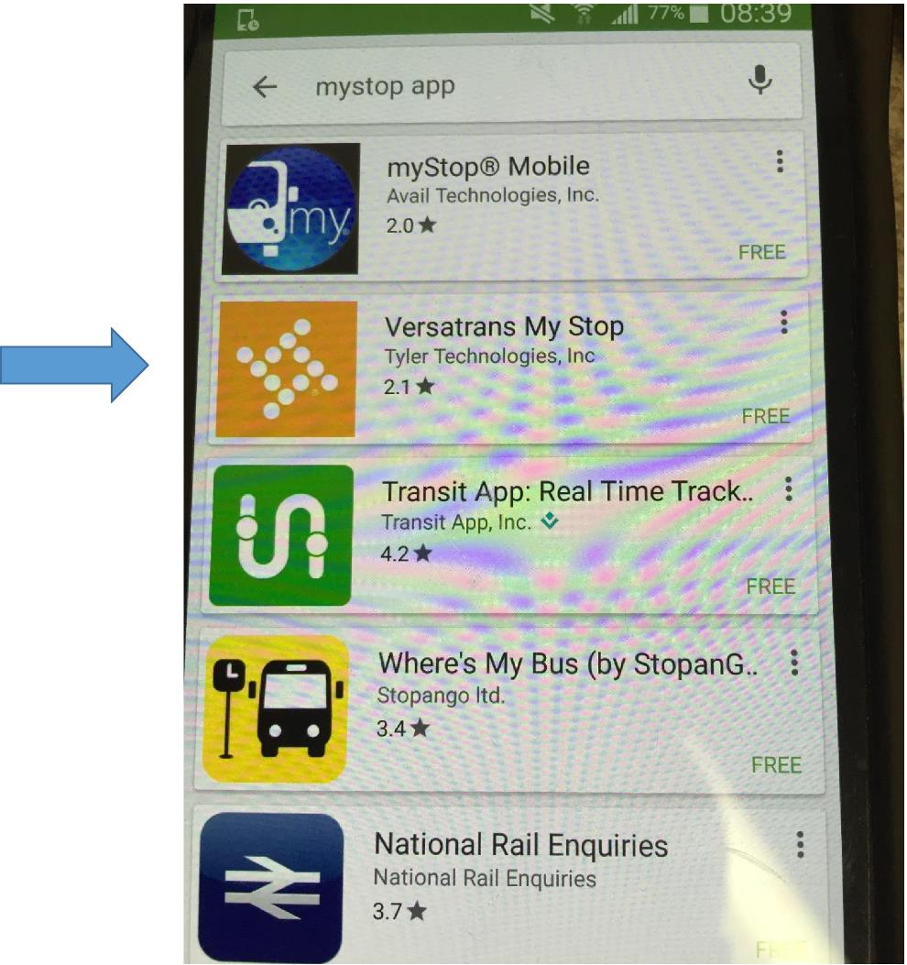
My Stop
Download
The App Store will
come up with several
choices for the app.
The App that you
would like to down
load is Versatrans My Stop

Slide 5
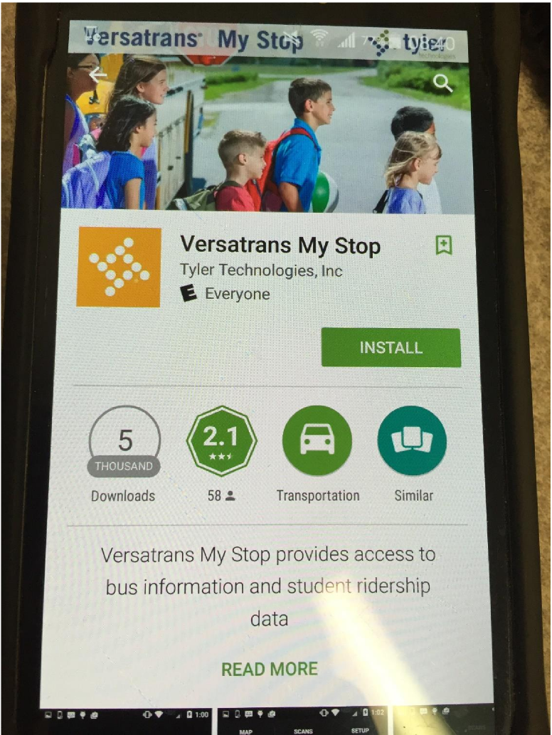
My Stop
Download
Once you select the Versatrans My Stop, the Install Screen will appear, like the one shown to the right.

Slide 6
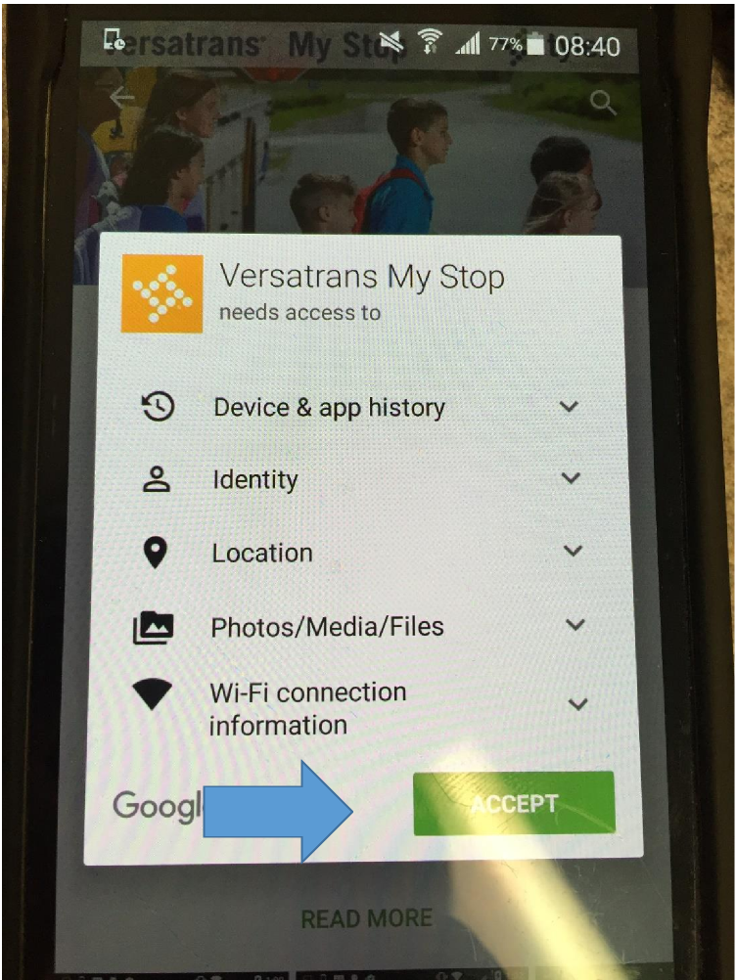
My Stop
Download
After clicking INSTALL, it will show you a warning message or message saying these are the items that the app needs access to.
Click on ACCEPT.

Slide 7
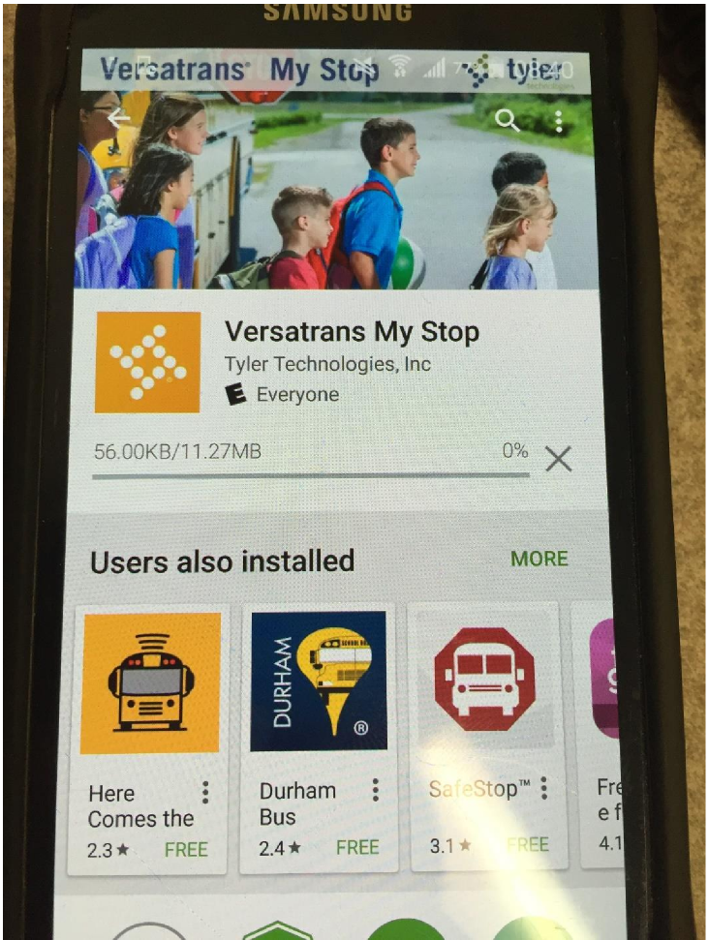
My Stop
Download
After hitting ACCEPT, the App store will download the App to your mobile device, as shown in the picture to the right.

Slide 8
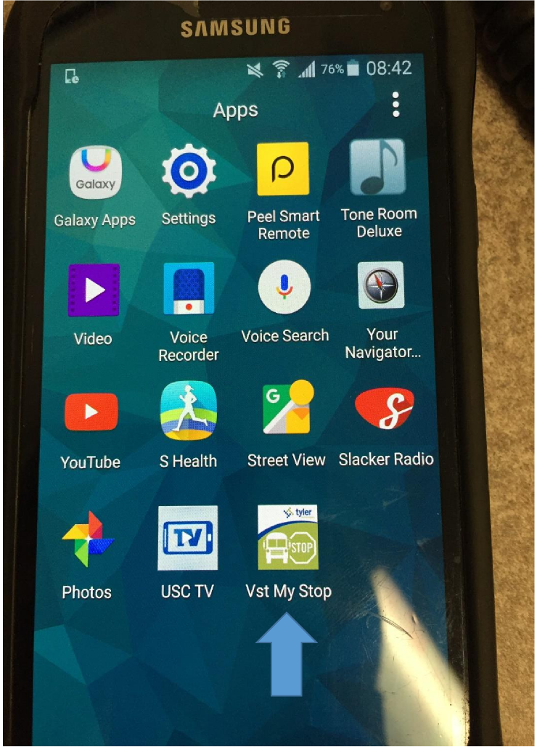
My Stop
Download
Once the Download is completed, the My Stop Icon will appear in your App menu.
The My Stop App icon will look like this on your mobile device.

Slide 9
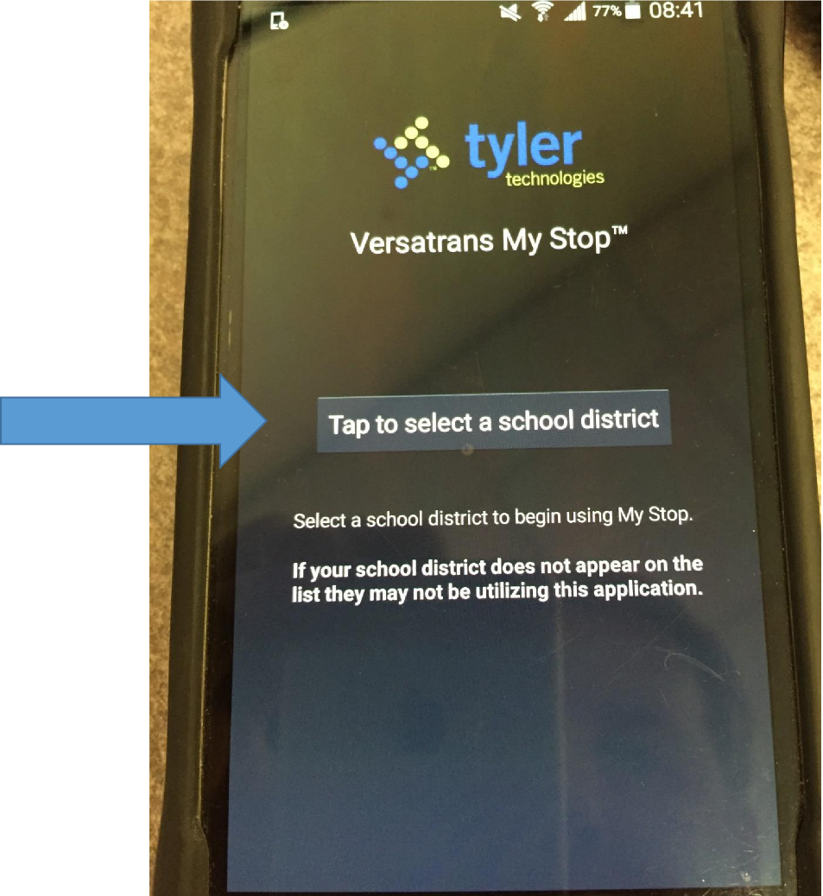
My Stop
Download
Once downloaded and the App is on your phone, press on the App and it will take you to this screen.
Tap on the label that says “Tap to select a school district”

Slide 10
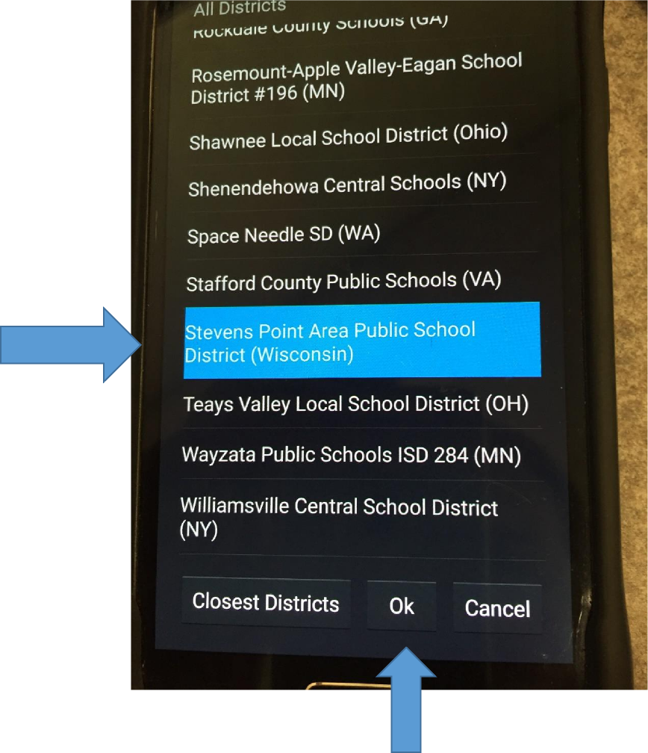
My Stop
Download
The App will provide a listing of schools that use this service, scroll down the list until you see Fond du Lac School District (Wisconsin). This includes North Fond du Lac School District.
Tap/Click to highlight it, then click on Ok at the bottom.

Slide 11
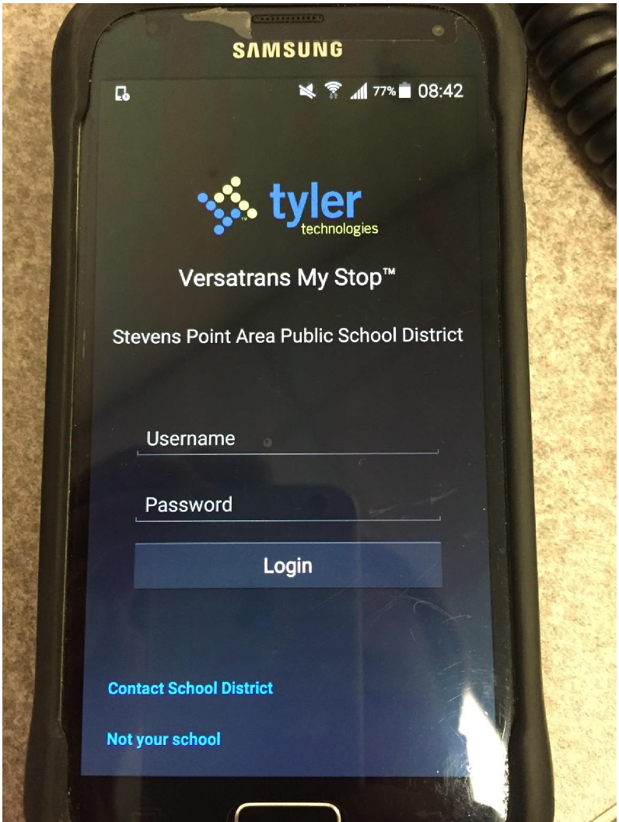
My Stop
Download
Once the App is
downloaded and Fond du Lac
School District has been assigned to your App, the App will provide you the main screen as shown in the right.

Slide 12
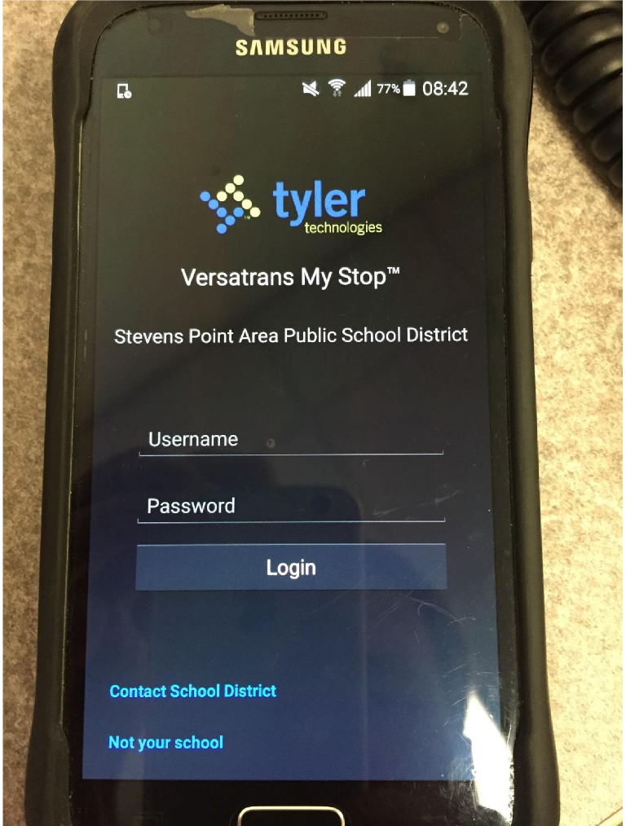
My Stop
Download
The USERNAME that will be used is the N and the other student’s ID#.
The ID# is the (5) digit number located in the Skyward Family Access for each of your students. The password will be N and the other student ID# for the first log in only. You will be prompted to assign your own password.

Slide 13
My Stop
Download
Each student will have his/her own routing information.
If you have any questions concerning the application, please do not
hesitate to contact Johnson School Bus at 920-921-3003.

